Slide 1
Tax Consideration for Foreigners Living in the USA
February 3, 2021

Slide 2
Welcome
C. Joseph Ciccarello, CPA, MST
Partner
Gray, Gray & Gray, LLP
781.407.0300
jciccarello@gggllp.com
Derek B. Rawls, CPA, MST
Partner
Gray, Gray & Gray, LLP
781.407.0300
drawls@gggllp.com

Slide 3
Today’s Agenda
Definition of Resident vs. Nonresident
Taxation of Nonresident and Tax Treaties
Tax Identification Numbers for Aliens
Taxation of Aliens by Visa Type and Immigration Status
Foreign Bank and Financial Accounting Reporting
Withholding of Federal Tax on Nonresident Aliens and Foreign Corporations
Potential Tax Law Changes Under Biden

Slide 4
US / Italian Tax Treaty

Slide 5
Resident vs. Nonresident
Definition - You are a resident alien of the US (for tax purposes) if you meet either of the following tests:
The green card text (lawful permanent resident) or
The substantial presence test or 183-day test (1/2 the year)

Slide 6
Resident vs. Nonresident
Tax Treatment of Resident vs. Nonresident Status
Resident Alien
Taxed on Worldwide income (all income from all sources)
Can generally claim same deductions as a US citizen
Nonresident Alien
Taxed on US source income
Claims fewer deductions

Slide 7
Resident vs. Nonresident
Tax Treatment of Resident/Green Card Holders
Required to obey the laws of the US and its’ states
Required to file tax returns and report all Worldwide income to IRS and state taxing authorities
Enjoy same rights as US citizens and are taxed the same as US citizens

Slide 8
Resident vs. Nonresident
Useful Information
IRS Publication 519 – US Tax Guide for Aliens
www.IRS.gov
Under the forms and publications tab

Slide 9
Resident vs. Nonresident
Useful Information
Were you physically present in the US for at least 183 days during the year?
If “yes” and your visa doesn’t meet an exception for reporting your income, you are a RESIDENT
If “no”, use numeric formula:
31 days in present year
1/3 days in prior year
+ 1/6 days in 2nd prior year
If this totals 183 or more, you are a RESIDENT ALIEN
There are exceptions to the Substantial Presence Test

Slide 10
Taxation of Non-Residents
File a 1040NR
Pay taxes on US source income only
Less deductions and credits than residents
Married Filing Join is generally not available
Taxpayers must itemize deductions (limited)
Income divided in 2 categories:
Incomes connected with a trade or a business in the US (taxed at the rates applicable to US citizens)
Income not connected with a trade or business (30% tax rate applies)

Slide 11
Taxation of Non-Residents
Tax Treaties
Often lower the 30% tax rate (refer to IRS Publication 901-US Tax Treaties)
Allows residents of foreign countries to be taxed at a reduced rate
Allows residents of foreign countries to be exempt from US income tax on certain items of income received from US sources
Treaty provisions are reciprocal
If you are a Non-Resident, be sure to use treaty benefits in your tax planning/strategy

Slide 12
Tax Identification Numbers
Every individual who files a US tax return or who is a dependent on a US tax return needs an Individual Tax Identification Number (ITIN) or a Social Security Number (SSN).
To obtain an ITIN, you must file a FORM W-7 (enclosed in this packet) with your tax return
IRS wants proof of tax filing prior to issuing ITINs
IRS states they will not alert immigration for ITIN applicants who are unlawfully in the US Allows residents of foreign countries to be taxed at a reduced rate
If you are being sponsored to work in the US, your employer will obtain the ITIN/Social Security Number
ITINs are only used for tax reporting and serve no other purpose
ITINs do not give you authorization to work in the US
ITINs expire after 5 years (effective 1/1/13)

Slide 13
Taxation of Aliens (exceptions to Substantial Presence Test)
Individuals Exempt from US Taxation:
Residents of Italy who receive income for personal services as independent contractors or self-employed individuals in the US, if they have no fixed base regularly available to them in the US. (refer to IRS publication 901 page 8 for details)
A professor or teacher who is a resident of Italy and whose visit is expected to last no more than two years to teach or conduct research at an educational institution or medical facility primarily funded from government sources. (refer to IRS publication 901, page 7 for details)
A student or business apprentice who is a resident of Italy. (refer to IRS publication 901, page 22 for details)

Slide 14
Taxation of Aliens by Visa Type
Visa Types most common for employees:
H Workers in specialty occupations including professors & researchers
L Intercompany transferees
F Academic students
J Exchange visitors who promote business or medical training
E Investors

Slide 15
Taxation of Aliens by Visa Type

Slide 16
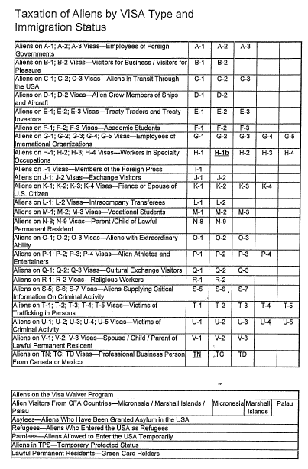
Taxation of Aliens by Visa Type and Immigration Status

Slide 17
Foreign Bank & Financial Account Reporting
All US citizens, residents and green card holders are required to report a financial interest (ownership), signature authority or other authority over one or more financial accounts in any foreign country.
Highest value is at any point during the year – not necessarily year-end.
FinCEN Form 114 – Report of Foreign Bank and Financial Accounts Files separately.
Form 8938 – Statement of Specified Foreign Financial Assets Has higher reporting thresholds. Filed with federal income tax return.

Slide 18
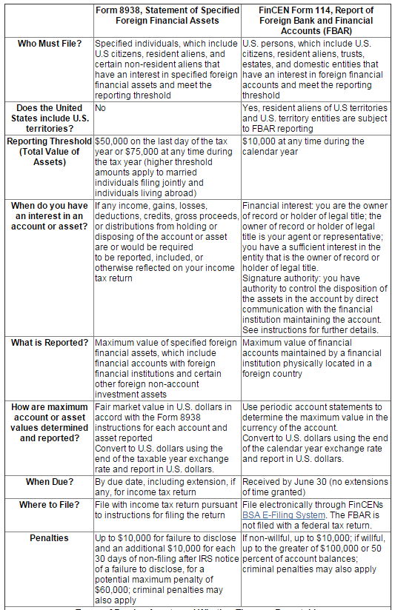
Foreign Bank & Financial Account Reporting
Information from www.irs.gov/Businesses/Comparison-of-Form-8938 -and-FBAR-Requirements

Slide 19
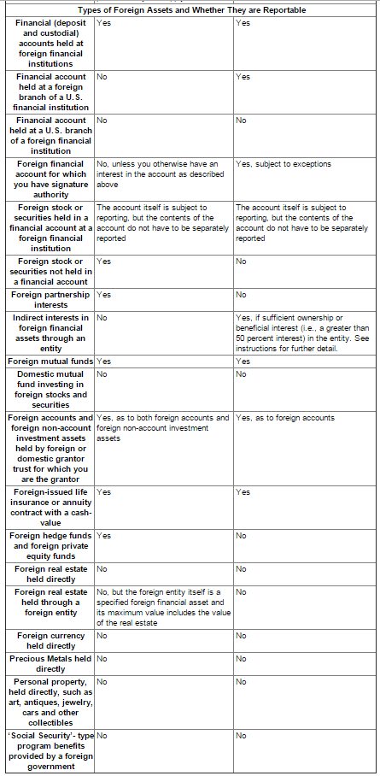
Foreign Bank & Financial Account Reporting
Information from www.irs.gov/Businesses/Comparison-of-Form-8938 -and-FBAR-Requirements

Slide 20
Federal Tax Withholdings
Foreign persons are subject to 30% tax rate on income they receive from US sources that consist of:
Interest
Dividends
Rents
Royalties
Premiums
Annuities
Compensation from services performed
Substitute payments in securities lending transaction
Other fixed or determinable annual or periodical gains, profits or income

Slide 21
Federal Tax Withholdings
Forms
Form W-8BEN-Foreign Individuals
Documents foreign status to US withholding agents
Establishes foreign status to claim reduced tax rate or claim an exemption from withholding as a resident of a foreign country
Needs to be files prior payment or the withholding agent should withhold tax at 30%
Form W-9-US Citizens & Resident Aliens
Use for exemption from withholding purposes instead of Form W-8BEN

Slide 22
Federal Tax Withholdings
Forms
Form W-8BEN-E is used for entities
Form W-8ECI is used for beneficial owners who claim that income is effectively connected with the conduct of trade of business within the US (with the exception of personal services)
Form 8233 or W-3 is used for beneficial owners who are receiving compensation for personal services performed in the US
Refer to IRS publication 515, Witholding of Tax on Nonresident Aliens and Foreign Corporations for further details. For copies of the aforementioned forms, visit www.irs.gov.

Slide 23
Top Rate on Ordinary Income
Current Law
Top rate 37% (reduced from 39.6% by President Trump’s legislation)
Rates begin at 10% and rise to 37% with intermediary rates of 12%, 22%, 24%, 32%, and 35% under the U.S. progressive tax system
Biden’s Plan
Raise only the top rate of 37% back to 39.6%
This bracket currently kicks in for single taxpayers with income in excess of $520,000 and married taxpayers with income in excess $620,000

Slide 24
Top Rate on Long-Term Capital Gains & Qualified Dividends
Current Law
High of 20%
Most American's pay 15%
Those in the 10% and 12% brackets pay 0%
Biden’s Plan
Increase the top rate from 20% to 39.6% for taxpayers earning more than $1 million

Slide 25
Payroll Taxes
Current Law
Employer and employee split a 12.4% tax on earnings up to the Social Security wage base cap, which in 2020 is $137,700
For ALL wages, the employer and employee split a 2.9% Medicare tax
If you're self-employed, you're on the hook for the full 15.3% (though you do get to deduct half on your income tax return)
As part of Obamacare, those who earn more than $250,000 (if married, $200,000 if single) are subject to an additional 0.9% payroll tax
Biden’s Plan
Lift the cap on the Social Security payroll tax, but ONLY ON WAGES IN EXCESS OF $400,000
Creates a donut hole. An employee paid a $500,000 salary would pay:
the 6.2% Social Security tax on the first $137,700,
no Social Security tax on wages from $137,700 to $400,000,
and then another 6.2% tax on the wages between $400,000 and $500,000.
He or she would also pay the 1.45% Medicare tax on all wages and the 0.9% Obamacare tax on wages over $250,000 (if married)

Slide 26
Elimination of the 20% Qualified Business Income Deduction
Current Law
The TCJA allows taxpayers who operate businesses as an S corporation, partnership, or sole proprietorship to claim a deduction equal to 20% of the qualified income earned in the business
This reduces the effective top rate on this type of income from 37% to 29.6%
Biden’s Plan
Phase-out the deduction for those taxpayers with taxable income in excess of $400,000

Slide 27
Itemized Deductions
Current Law
Taxpayers are entitled to deduct the greater of:
the standard deduction, or
the sum of the itemized deductions (things like mortgage interest, medical expenses, state and local income and property taxes, and charitable contributions)
The TCJA nearly doubled the standard deduction (from $6,350 to $12,400 for single taxpayers, $12,700 to $24,800 for married couples), while limiting or eliminating certain itemized deductions (a confluence of changes that decreased the number of filers who will itemize from 30% in 2017 to 11% in 2018)
While certain itemized deductions are subject to limitation (ex. the deduction for state and local income and property taxes is capped at $10,000) there is no longer any overall limitation on a taxpayer's itemized deductions as there was prior to 2018
Biden’s Plan
For those earning in excess of $400,000, he would reinstate the Pease limitation (reduces a taxpayer’s total itemized deductions by 3% for every dollar that income exceeds $400,000)
Cap the benefit of itemized deductions at a 28% rate for those whose income exceeds $400,000

Slide 28
Corporate Tax
Current Law
21% corporate income tax rate (TCJA reduced from 35%)
Biden’s Plan
Raise the corporate income tax rate to 28%.
Implement a new form of the “alternative minimum tax” requiring corporations with financial statement income in excess of $100 million to at the very least pay tax of 15% on its financial statement income.

Slide 29
Estate Tax
Current Law
Value of your assets (your estate) is taxed at a rate of 40%
But only total assets worth more than $11.58 million are taxed
When you die, your heirs take your assets with a “stepped-up” basis equal to their fair market value; thus, while the VALUE of the assets may be taxed, any appreciation in the assets will not be taxed when they transfer from decedent to beneficiary
Biden’s Plan
The rate would rise to 45%
The exemption would drop to $3.5 million
Death would suddenly become a realization event (any appreciation in your assets would be taxed upon your demise)

Slide 30
Questions?
C. Joseph Ciccarello, CPA, MST
Partner
Gray, Gray & Gray, LLP
781.407.0300
jciccarello@gggllp.com
Derek B. Rawls, CPA, MST
Partner
Gray, Gray & Gray, LLP
781.407.0300
drawls@gggllp.com

Slide 31
Contact Us
Gray, Gray & Gray, LLP
150 Royall Street, Suite 102 Canton, MA 02021
www.gggllp.com
781.407.0300

Slide 32
Disclaimer
The content of this seminar is intended for educational purposes only.
This seminar provides a brief summary based on our understanding and interpretation of current law. All tax references are to federal tax law only, unless otherwise stated.
The information contained in this seminar is general in nature and is based on authorities that are subject to change. It is not, and should not be construed as accounting, legal or tax advice or opinion provided by Gray, Gray & Gray, LLP. The material presented may not be applicable to, or suitable for, specific circumstances or needs, and may require consideration of non-tax factors and tax factors not described herein. Contact Gray, Gray & Gray or another tax professional prior to taking any action based upon this information. Changes in tax laws or other factors could affect, on a prospective or retroactive basis the information contained herein; Gray, Gray & Gray assumes no obligation to inform the reader/seminar attendee of any such changes.
The material presented in this seminar is not intended to, and cannot be used to, avoid IRS penalties. This material supports the marketing and promotion of accounting services. Seek advice based on your particular circumstances from independent tax, legal accounting, insurance, investment and financial advisors.

